Slide 1
ASH: The Answer Set Programming based Hierarchical Abstraction Planner for Robots
Oliver Michael Kamperis
Marco Castellani
Yongjing Wang

Slide 2
Motivation
Planning requires reasoning about and making a series of related decisions regarding action and state change into an often large future temporal horizon prior to, or during, execution.
Classical “flat” planning is intractable for non-trivial problems;
Search space exponential in description size,
Number of solutions exponential in plan length,
Finding a plan is best case polynomial and worst case NP-hard,
Determining solution existence is PSPACE-complete.
In real-world, offline complete planning is non-feasible and futile.
Need to be able to rapidly partial plan (and repair plans) online.

Slide 3
Motivation
To overcome this we must either;
Find some way to guide search, e.g. problem-specific heuristics,
Find some way to split the problem and plan online.
Why use abstraction?
Provides domain-independent guidance to search,
Allows online partial planning,
Find good solutions very quickly.
This is the human-like approach to planning;
Decide which part of the problem are details,
Abstract away details whilst they have low-relevance, deal with them later,
Find some abstract structure to the plan, maintain this structure throughout.

Slide 4
What is Hierarchical Abstraction Planning?
Many approaches in AI use abstraction and/or hierarchies.
ASH is a planning domain abstraction planner;
Abstractions are applied to the domain’s definition in a upwards manner,
Plans are generated and refined in a downwards manner.
Basic general concepts;
Represent the planning domain over an abstraction hierarchy,
Generate a plan at the most abstract level,
This plan forms a “skeleton” solution,
Solution at next level requires refining skeleton into more concrete plan,
Keep refining until ground level plan is obtained.

Slide 5
ABSTRIPS and ALPINE
ABSTRIPS [Sacreboti 1974] and ALPINE [Knoblock 1982] are previous planning domain abstraction planners.
Both are based on “ignoring” action preconditions.
Showed that abstract domain models are best case exponentially faster to solve (if they hold certain properties).
ABSTRIPS/ALPINE method;
Abstract plans form skeletons,
Each action of skeleton is a sub-problem that must be solved independently,
Skeleton then refined by recursively solving sub-problems,
Fast because the sum of the solving times for each sub-problem is far less than the time taken to solve the entire problem!

Slide 6
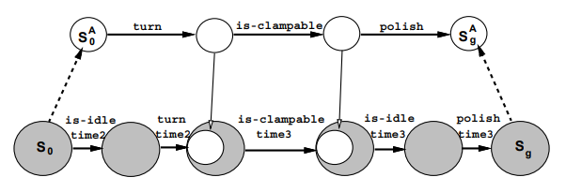
ABSTRIPS and ALPINE
Solving each sub-problem requires generating additional sub-sequence of actions that satisfy the newly introduced preconditions of the skeleton's actions that were previously abstracted away.
Problematic because independence assumption often fails, i.e. sub-problems often interact with each other!

Slide 7
Why don’t we see more Abstraction Planners?
Cannot guarantee any saving, sometimes plans are much worse, why?
Difficult to define good abstractions, there are some properties that we can use, but these are difficult to determine in general.
Planners are complex, hard to support a large range of abstractions.
Each sub-problem treated and solved independently;
No interleaving means low flexibility, can result in exponentially longer plans,
Can force backtracking (partially solved by ALPINE, only for relaxed models).
The main problem is that “division on preconditions” is inflexible, solutions for this are to only construct “good” abstraction, does not address the fact that the planner needs to have more “control”.

Slide 8
Desirable Properties of Abstraction Hierarchies
Monotonicity property;
If concrete solution exists, abstract solution exists, of similar structure.
Downwards refinement property (DRP);
If previous holds, then any abstract plan can be refined without backtracking,
Important, ASH does not allow backtracking, because it is not possible!
Can we define when ASH domain has this?
Yes, based on answer set semantics.
Can we check if an ASH domain has this?
Yes, but have to construct entire transition system!
Could define a general theory for constructing abstractions that have this.

Slide 9
How does ASH differ from previous Planners?
ASH is conceptually similar, but fundamentally different in theory.
ASH plan refinement is “constraint addition” based;
Skeleton solution is formed by effects of actions passed as sub-goals;
Sub-goals apply conformance constraint which limits number of solutions,
Constraint simply enforces that plans at all levels achieve the same effects,
Requires the ability to reason about state representation at different levels.
 | ABSTRIPS and ALPINE | ASH
Solving | Recursive | Iterative
Backtracking | Yes | No
Problem Division | On action preconditions | On action effects

Slide 10
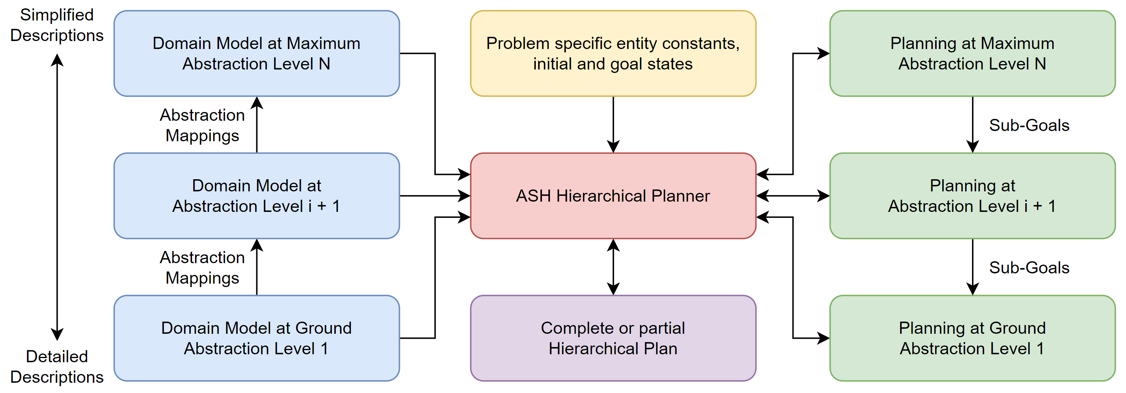
Hierarchical Planning with ASH
Planning domain it represented by abstraction hierarchy of domain models;
Design sufficiently expressive ground model to deal with the application,
Abstractions are then created through various methods,
Abstraction mappings define relationship between state over abstractions.
Iteratively solve planning problems in descending order;
Only at the most abstraction level does a complete plan have to be generated,
At lower levels, sub-goals guide search and allow problem division.

Slide 11
Why is it better to divide on action effects?
Sub-problems are independently solvable,
And so is any finite sub-sequence of sub-problems!
It is possible to deal with interacting sub-goals!
More flexible, allows interleaving;
It does not matter which state we start in, if problem has DRP then always solvable,
Can account for later sub-goals earlier, or delay sub-goal achievement,
Without changing the plan structure, so each planning level is still monotonic!
Works for any type of abstract model, but requires abstraction mappings.
Define sub-goal based conformance constraint and problem division;
Each action of an abstract plan is head of a decomposition tree,
Completing each decomposition tree is a sub-problem,
These make refinement of plans much easier to define.

Slide 12
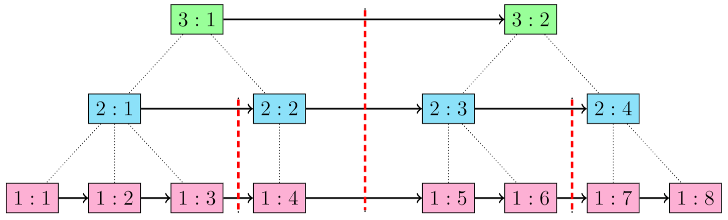
Decomposition Trees in ASH
Nodes are of the form [ abstraction level : time step ].
Red lines are possible divisions or sub-divisions;
Each division is a decomposition tree or sub-sequence of trees,
Levels are solved iteratively top-to-bottom,
Divisions are solved iteratively left-to-right.
Notes:
You can solve all the trees or you can solve any sub-set of the trees, starting from the left most unsolved tree.

Slide 13
Sub-problem Interleaving in ASH
Consider an robot picking up two objects from a room;
Objects are both in same room, but in different specific places,
Robot has to extend arm to grasp object, but can’t move with extended arms.
Abstract plan is;
move(room)
{extend(arm_1), extend(arm_2)}
{pick(obj_1), pick(obj_2)}
Sub-goals are;
in(robot, room)
{extended(arm_1), extended(arm_2)}
{grasping(obj_1), grasping(obj_2)}

Slide 14
Sub-problem Interleaving in ASH
Sub-goals are;
in(robot, room)
{extended(arm_1), extended(arm_2)}
{grasping(obj_1), grasping(obj_2)}
Best ground plan is;
move(c_1)
extend(arm_1)
pick(obj_1)
retract(arm_1)
move(c_2)
move(c_3)
extend(arm_2)
pick(obj_2)
Worst ground plan is;
move(c_1)
{extend(arm_1), extend(arm_2)}
pick(obj_1)
{retract(arm_1), retract(arm_2)}
move(c_2)
move(c_3)
extend(arm_2)
pick(obj_2)

Slide 15
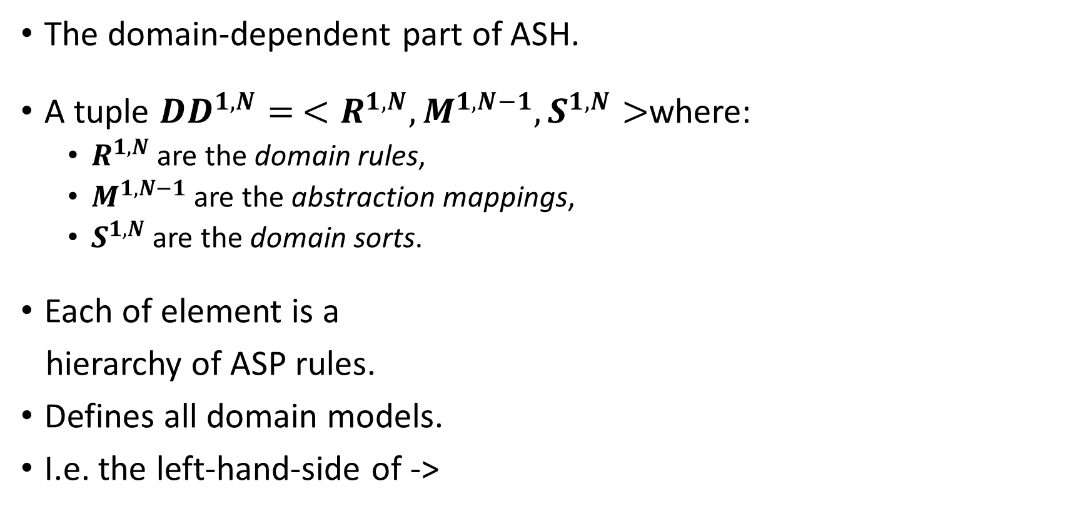
Hierarchical Planning Domain Definitions
The domain-dependent part of ASH.
A tuple ${DD}^{1,N}= <R^{1,N},M^{1,N−1},S^{1,N}>$where:
$R^{1,N}$are the domain rules,
$M^{1,N−1}$ are the abstraction mappings,
$S^{1,N}$ are the domain sorts.
Each of element is a
hierarchy of ASP rules.
Defines all domain models.
I.e. the left-hand-side of ->

Slide 16
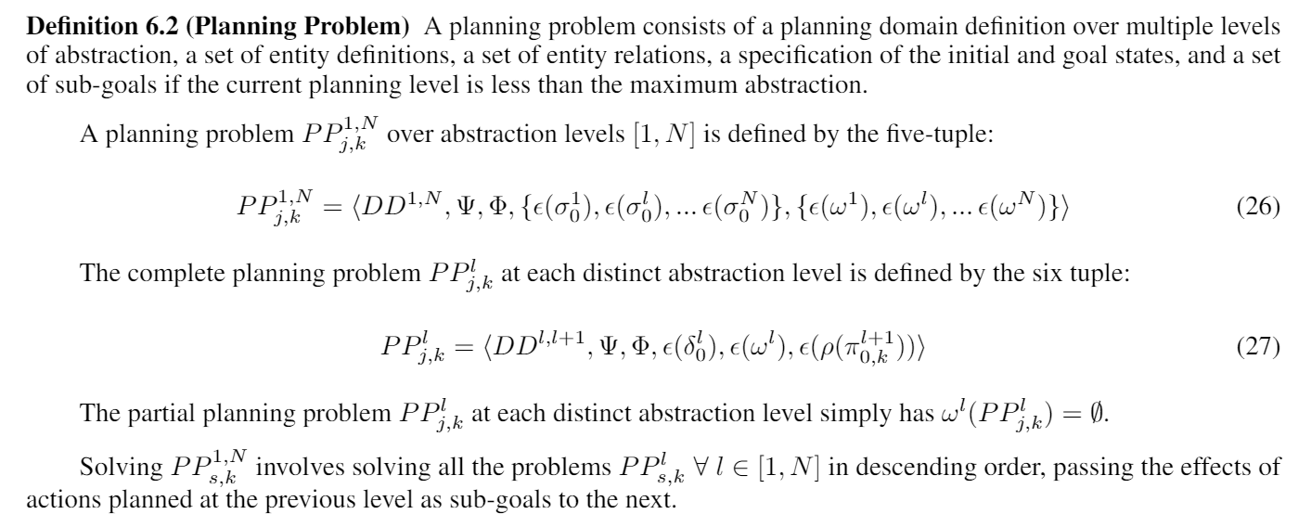
Planning Problems
Where; ψ is the entity constraints and φ the entity relations.

Slide 17
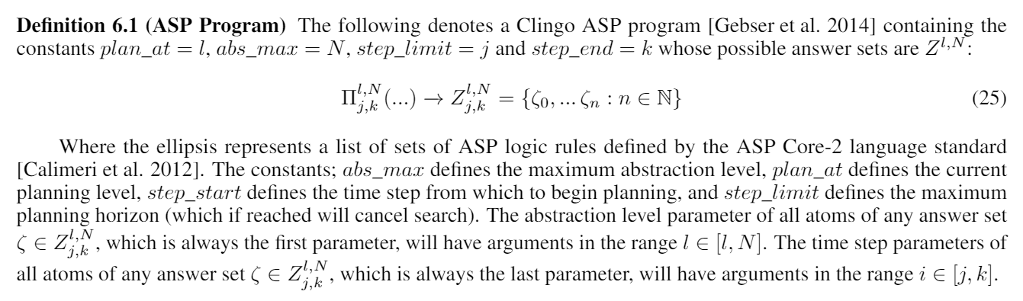

Preliminaries: ASP Programs
An ASP Program is denoted as:
$$Π_{j,k}^{l,N}\left(…\right)→Z_{j,k}^{l,N}=\{ζ_{0},…ζ_{n}\}$$

Slide 18
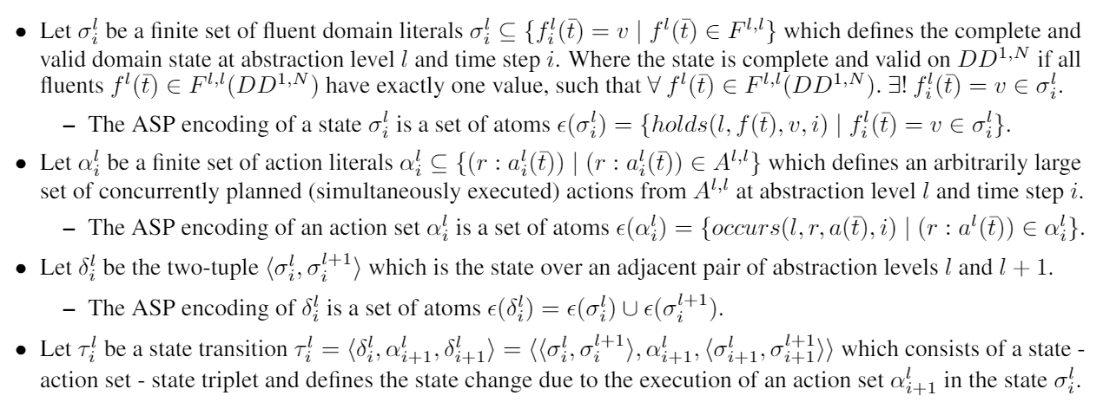

Preliminaries: Action and State Notation
A fluent literal; $f_{i}^{l}\left(\overline{t}\right)=v$
An action literal; $r :a_{i}^{l}\left(\overline{t}\right)$

Slide 19
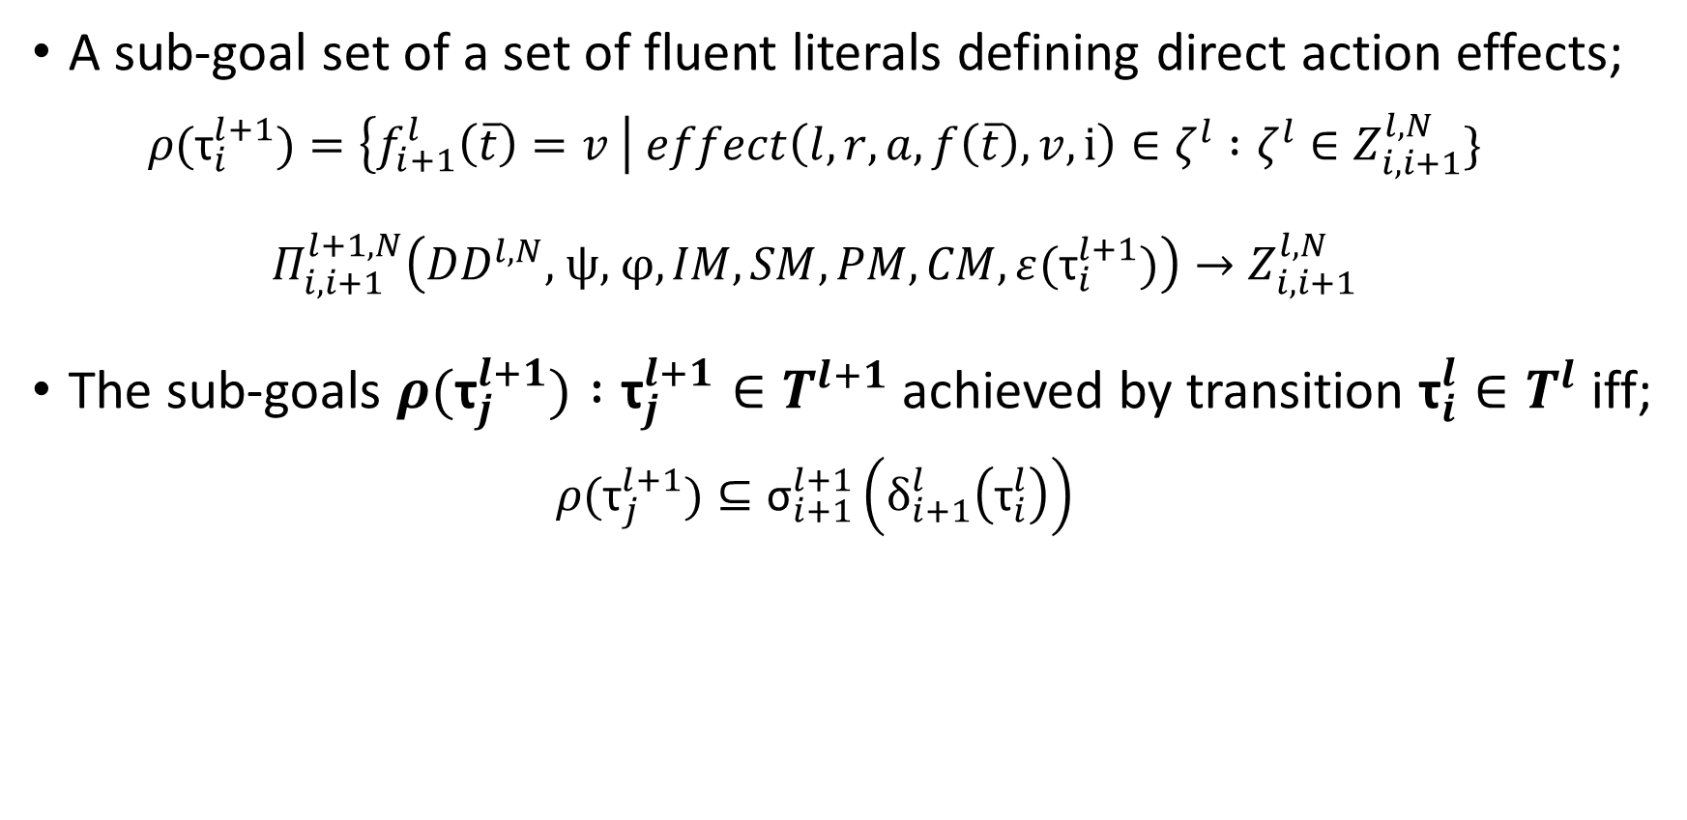
Preliminaries: Sub-Goals
A sub-goal set of a set of fluent literals defining direct action effects;
$${ρ(\text{τ}}_{i}^{l+1})=\left\{f_{i+1}^{l}\left(\overline{t}\right)=v \right| effect\left(l,r,a,f\left(\overline{t}\right),v,i\right)∈ζ^{l} :ζ^{l}∈Z_{i,i+1}^{l,N}\}$$
$$Π_{i,i+1}^{l+1,N}\left({DD}^{l,N}\text{, }\text{ψ}\text{, }\text{φ},IM,SM,PM,CM,ε({\text{τ}}_{i}^{l+1})\right)→Z_{i,i+1}^{l,N}$$
The sub-goals ${ρ(\text{τ}}_{j}^{l+1}) :{\text{τ}}_{j}^{l+1}∈T^{l+1}$ achieved by transition ${\text{τ}}_{i}^{l}∈T^{l}$ iff;
$${ρ(\text{τ}}_{j}^{l+1})⊆{\text{σ}}_{i+1}^{l+1}\left(δ_{i+1}^{l}\left({\text{τ}}_{i}^{l}\right)\right)$$

Slide 20
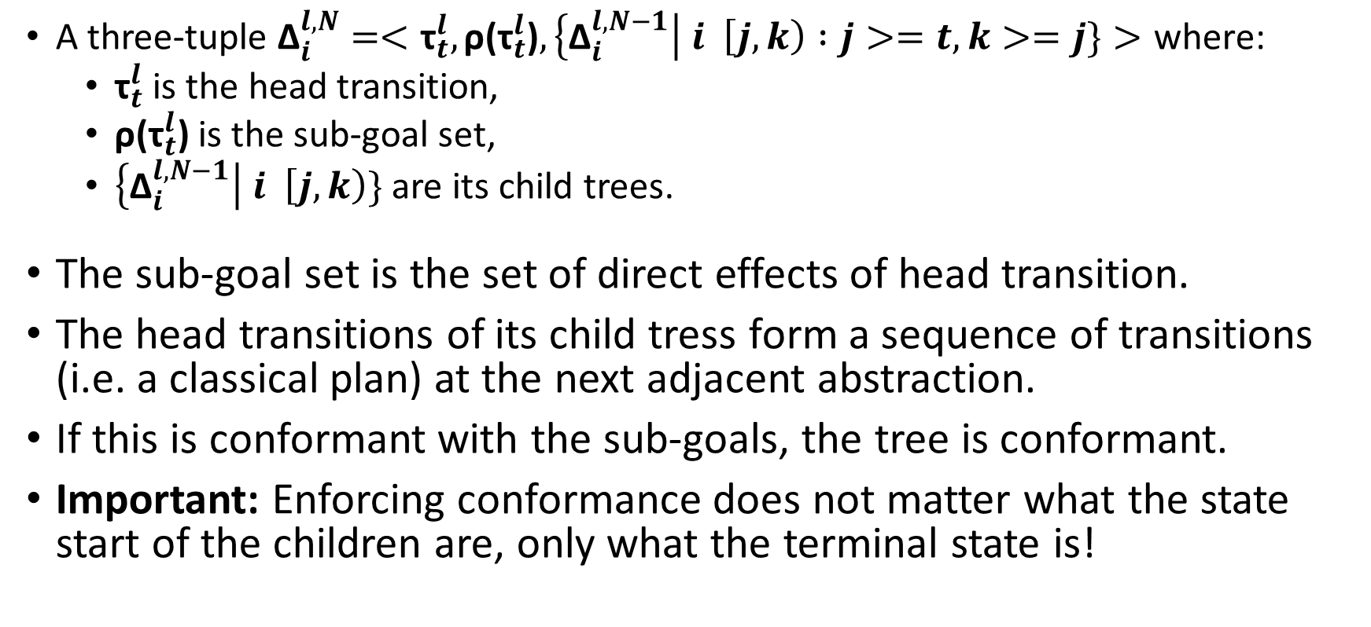
Decomposition Trees
A three-tuple ${\text{Δ}}_{i}^{l,N}=<{\text{τ}}_{t}^{l},\text{ρ}\text{(}{\text{τ}}_{t}^{l}\text{)},\left\{{\text{Δ}}_{i}^{l,N−1}\right| i \left[j,k\right) :j>=t, k>=j\}>\text{where}\text{:}$
${\text{τ}}_{t}^{l}$ is the head transition,
ρ(${\text{τ}}_{t}^{l}$) is the sub-goal set,
$\left\{{\text{Δ}}_{i}^{l,N−1}\right| i \left[j,k\right)\}$ are its child trees.
The sub-goal set is the set of direct effects of head transition.
The head transitions of its child tress form a sequence of transitions (i.e. a classical plan) at the next adjacent abstraction.
If this is conformant with the sub-goals, the tree is conformant.
Important: Enforcing conformance does not matter what the state start of the children are, only what the terminal state is!

Slide 21
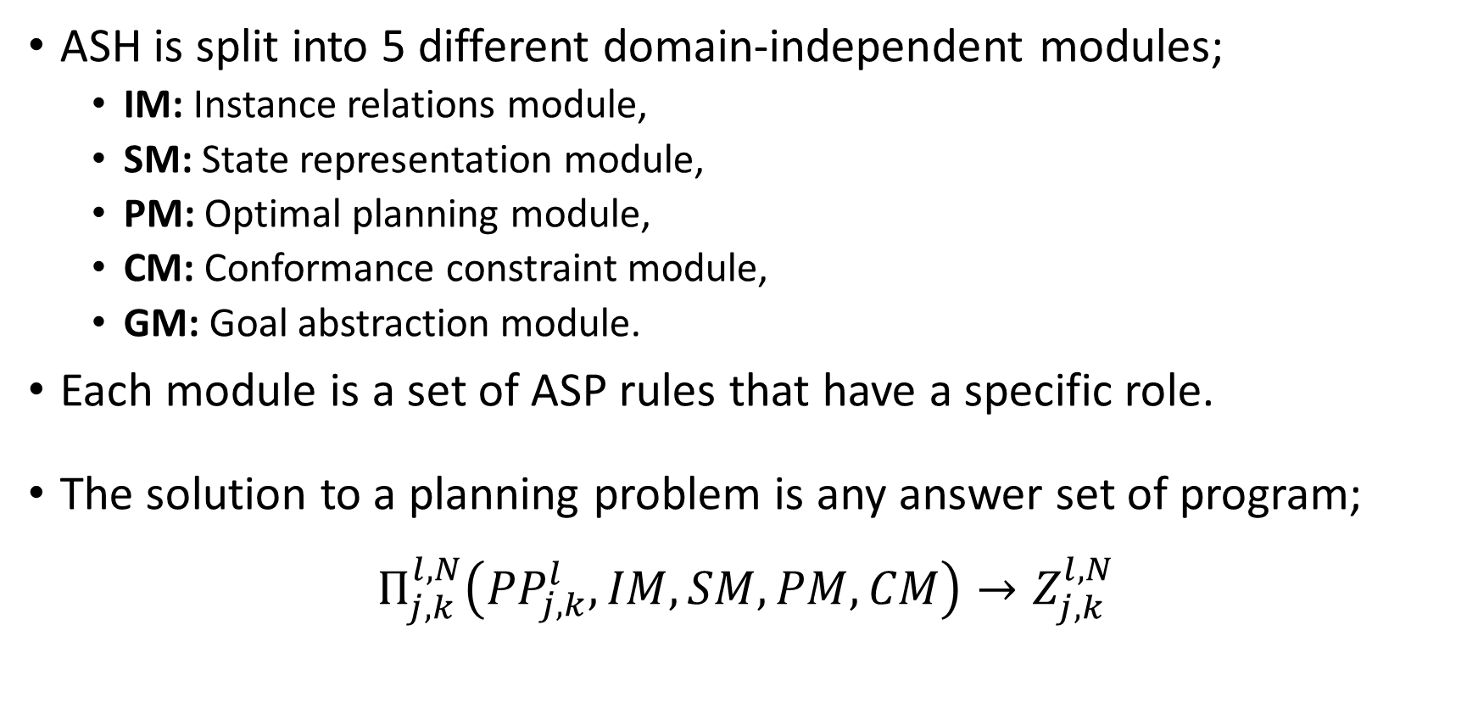
Modules of ASH
ASH is split into 5 different domain-independent modules;
IM: Instance relations module,
SM: State representation module,
PM: Optimal planning module,
CM: Conformance constraint module,
GM: Goal abstraction module.
Each module is a set of ASP rules that have a specific role.
The solution to a planning problem is any answer set of program;
$$Π_{j,k}^{l,N}\left({PP}_{j,k}^{l},IM,SM,PM,CM\right)→Z_{j,k}^{l,N}$$

Slide 22
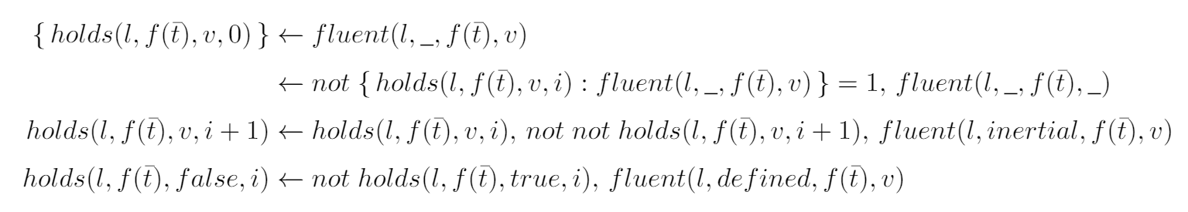
Modules of ASH: State Representation
Law of awareness - all fluents take some value in the initial state.
Law of continuity - must take exactly one value at any time.
Law of inertia - propagate value through time unless changed.
Closed world assumption for defined fluents - If a defined fluent is not deductively true then it is false.

Slide 23
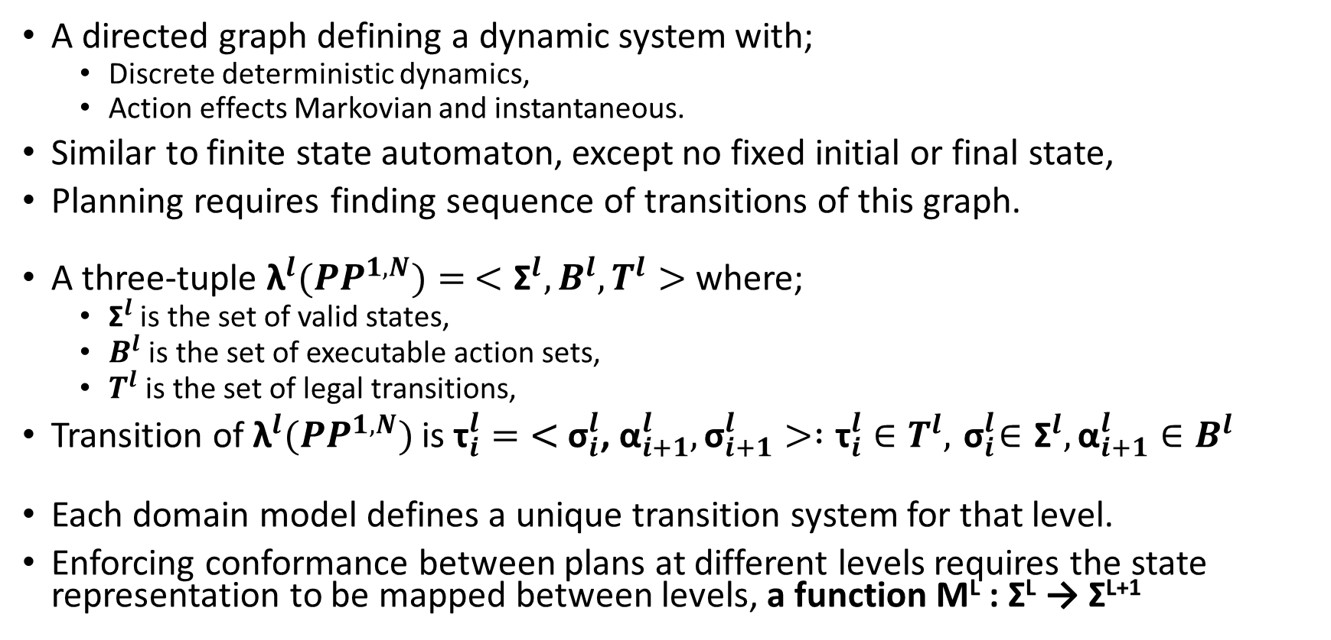
State Transition Systems
A directed graph defining a dynamic system with;
Discrete deterministic dynamics,
Action effects Markovian and instantaneous.
Similar to finite state automaton, except no fixed initial or final state,
Planning requires finding sequence of transitions of this graph.
A three-tuple ${\text{λ}}^{l}({PP}^{1,N})= <{\text{Σ}}^{l},Β^{l},Τ^{l}>$ where;
${\text{Σ}}^{l}$ is the set of valid states,
$Β^{l}$ is the set of executable action sets,
$Τ^{l}$ is the set of legal transitions,
Transition of ${\text{λ}}^{l}({PP}^{1,N})$ is ${\text{τ}}_{i}^{l}=\text{<}{ \text{σ}}_{i}^{l}\text{, }{\text{α}}_{i+1}^{l},{\text{σ}}_{i+1}^{l}> :{\text{τ}}_{i}^{l}∈T^{l},{ \text{σ}}_{i}^{l}∈{\text{Σ}}^{l},{\text{α}}_{i+1}^{l}∈Β^{l}$
Each domain model defines a unique transition system for that level.
Enforcing conformance between plans at different levels requires the state representation to be mapped between levels, a function M^{L} : Σ^{L} → Σ^{L+1}

Slide 24
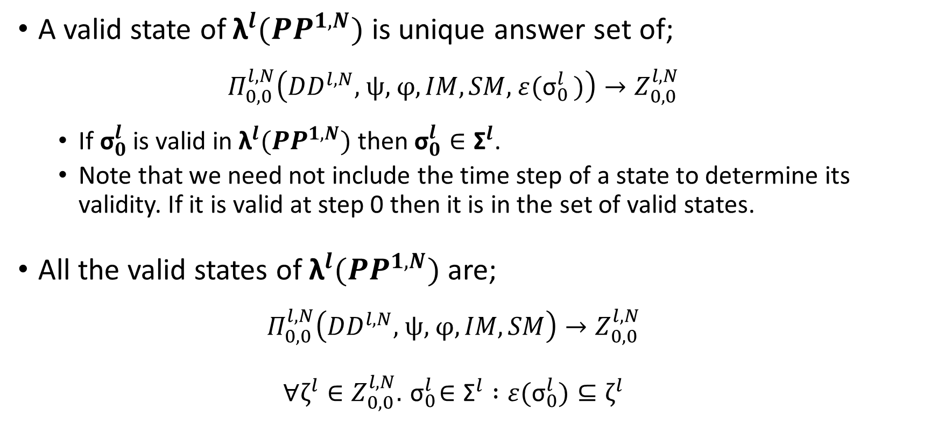
State Transition Systems
A valid state of ${\text{λ}}^{l}({PP}^{1,N})$ is unique answer set of;
$$Π_{0,0}^{l,N}\left({DD}^{l,N}\text{, }\text{ψ}\text{, }\text{φ},IM,SM{\text{, }ε(\text{σ}}_{0}^{l})\right)→Z_{0,0}^{l,N}$$
If${ \text{σ}}_{0}^{l}$is valid in ${\text{λ}}^{l}({PP}^{1,N})$ then ${\text{σ}}_{0}^{l}∈{\text{Σ}}^{l}$.
Note that we need not include the time step of a state to determine its validity. If it is valid at step 0 then it is in the set of valid states.
All the valid states of ${\text{λ}}^{l}({PP}^{1,N})$ are;
$$Π_{0,0}^{l,N}\left({DD}^{l,N}\text{, }\text{ψ}\text{, }\text{φ},IM,SM\right)→Z_{0,0}^{l,N}$$
$$∀ζ^{l}{∈Z}_{0,0}^{l,N}. { \text{σ}}_{0}^{l}∈{\text{Σ}}^{l} :{ε(\text{σ}}_{0}^{l})⊆ζ^{l}$$

Slide 25
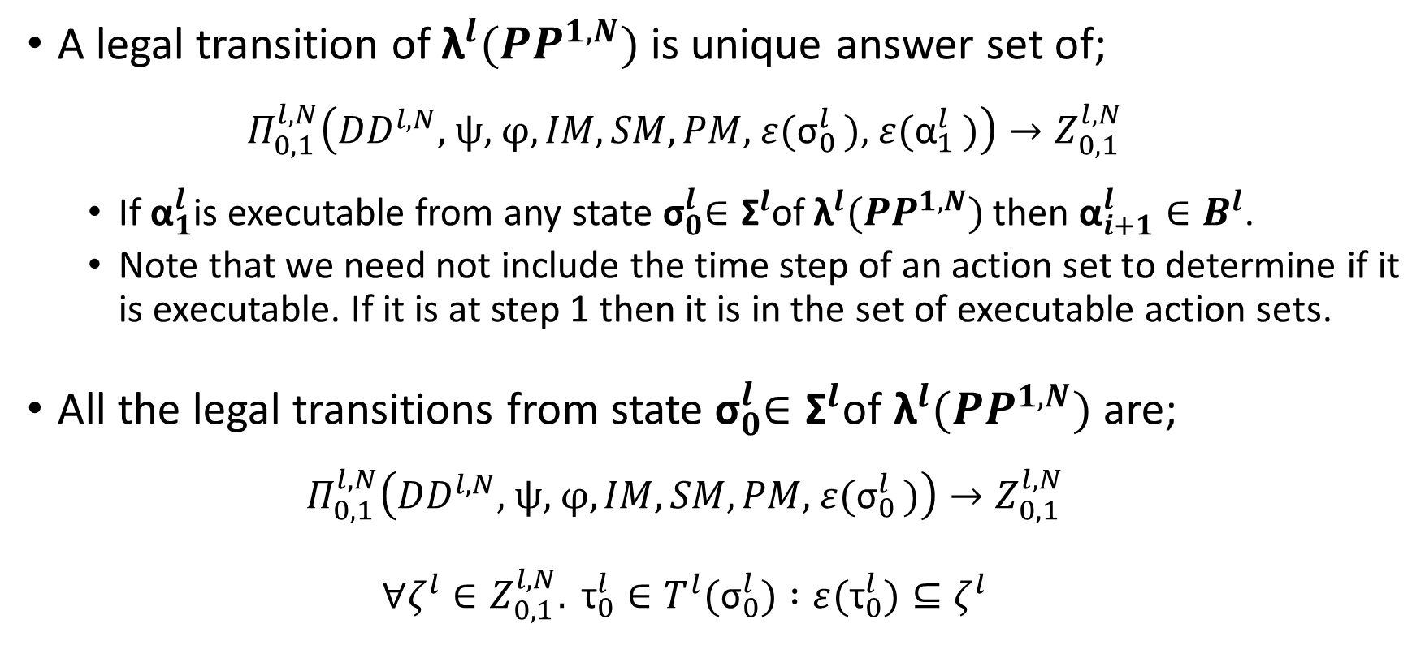
State Transition Systems
A legal transition of ${\text{λ}}^{l}({PP}^{1,N})$ is unique answer set of;
$$Π_{0,1}^{l,N}\left({DD}^{l,N}\text{, }\text{ψ}\text{, }\text{φ},IM,SM,PM{\text{, }ε(\text{σ}}_{0}^{l}){\text{, }ε(\text{α}}_{1}^{l})\right)→Z_{0,1}^{l,N}$$
If ${\text{α}}_{1}^{l}$is executable from any state${ \text{σ}}_{0}^{l}∈{\text{Σ}}^{l}$of ${\text{λ}}^{l}({PP}^{1,N})$ then ${\text{α}}_{i+1}^{l}∈Β^{l}$.
Note that we need not include the time step of an action set to determine if it is executable. If it is at step 1 then it is in the set of executable action sets.
All the legal transitions from state${ \text{σ}}_{0}^{l}∈{\text{Σ}}^{l}$of ${\text{λ}}^{l}({PP}^{1,N})$ are;
$$Π_{0,1}^{l,N}\left({DD}^{l,N}\text{, }\text{ψ}\text{, }\text{φ},IM,SM,PM{\text{, }ε(\text{σ}}_{0}^{l})\right)→Z_{0,1}^{l,N}$$
$$∀ζ^{l}{∈Z}_{0,1}^{l,N}. {\text{τ}}_{0}^{l}∈{T^{l}\text{(}\text{σ}}_{0}^{l}) :ε({\text{τ}}_{0}^{l})⊆ζ^{l}$$

Slide 26
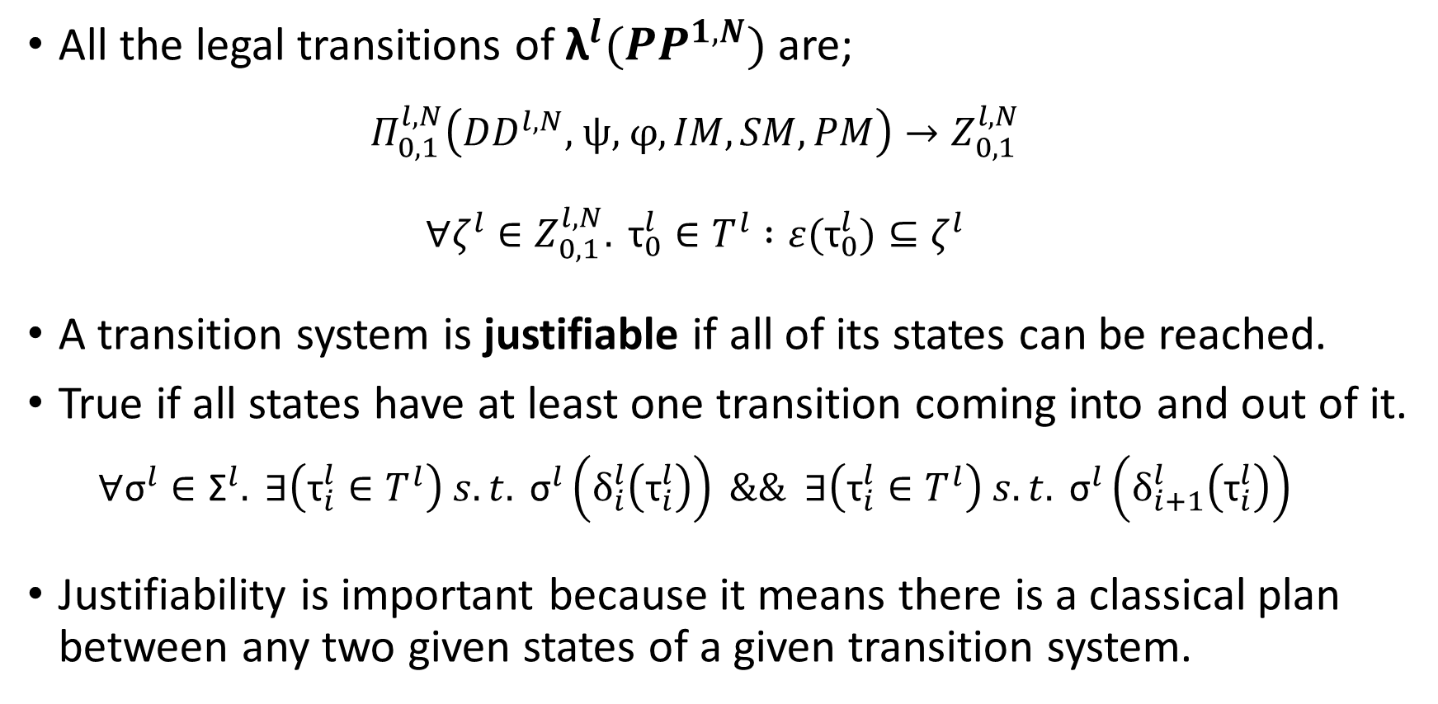
State Transition Systems
All the legal transitions of ${\text{λ}}^{l}({PP}^{1,N})$ are;
$$Π_{0,1}^{l,N}\left({DD}^{l,N}\text{, }\text{ψ}\text{, }\text{φ},IM,SM,PM\right)→Z_{0,1}^{l,N}$$
$$∀ζ^{l}{∈Z}_{0,1}^{l,N}. {\text{τ}}_{0}^{l}∈T^{l} :ε({\text{τ}}_{0}^{l})⊆ζ^{l}$$
A transition system is justifiable if all of its states can be reached.
True if all states have at least one transition coming into and out of it.
$$∀{\text{σ}}^{l}∈{\text{Σ}}^{l}. ∃\left({\text{τ}}_{i}^{l}∈T^{l}\right) s.t. {\text{σ}}^{l}\left(δ_{i}^{l}\left({\text{τ}}_{i}^{l}\right)\right) \&\& ∃\left({\text{τ}}_{i}^{l}∈T^{l}\right) s.t. {\text{σ}}^{l}\left(δ_{i+1}^{l}\left({\text{τ}}_{i}^{l}\right)\right)$$
Justifiability is important because it means there is a classical plan between any two given states of a given transition system.

Slide 27
Downwards Refinement Property
How do we ensure a planning problem has this property?
We have to determine if every sub-goal is downwards achievable;
This means that a sub-goal can be achieved from any starting state, i.e,
All transitions at level L are achievable with sequence of transitions at L – 1.
A sub-goal is downwards achievable if;
There is a transition at the next level that achieves the sub-goal,
The starting state of this transition is reachable from any state.
To check this, we need to solve a lot of ASP programs…
A program for every abstraction level (to construct the transition system),
A program for every transition of every non-ground level?

Slide 28
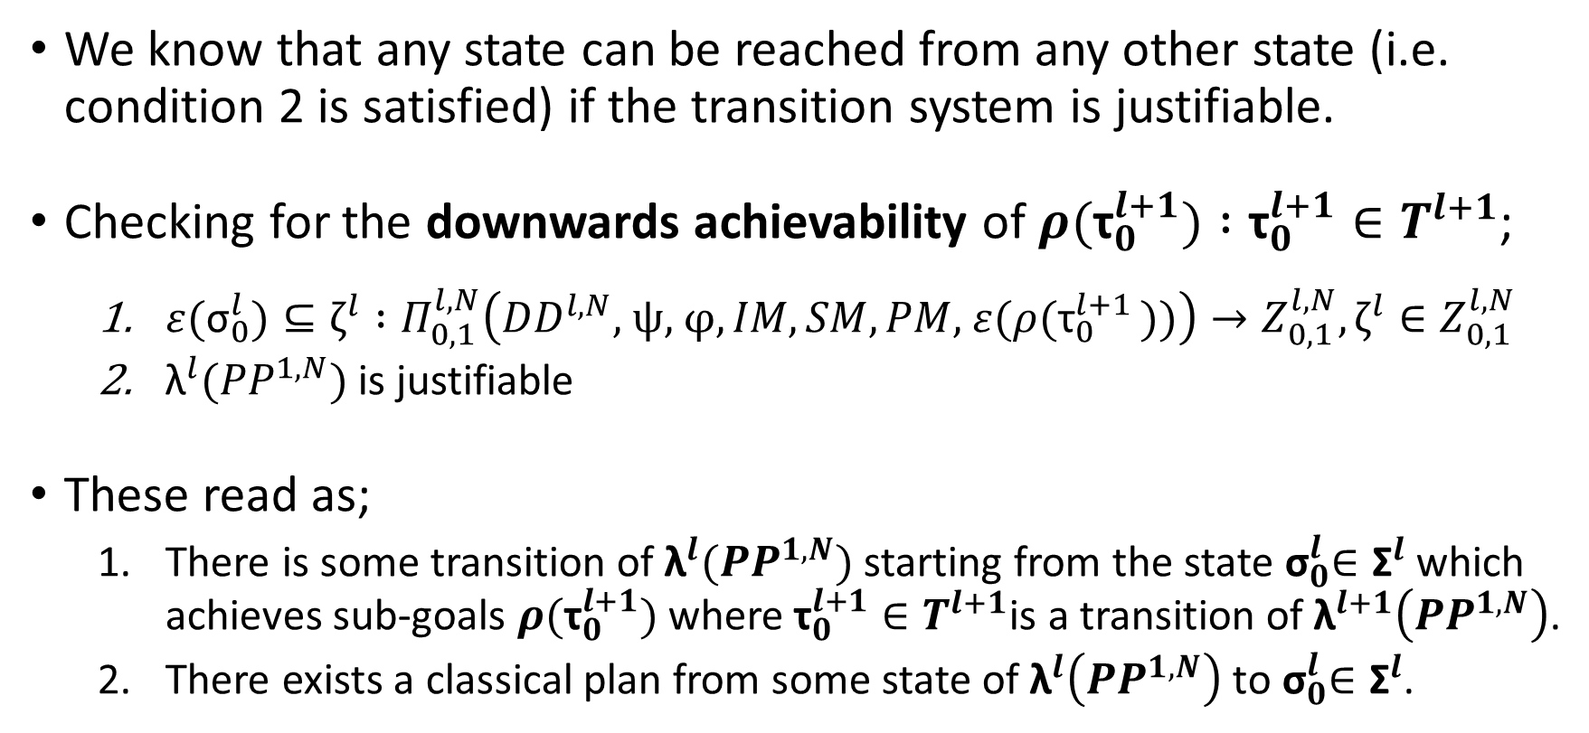
Downwards Refinement Property
We know that any state can be reached from any other state (i.e. condition 2 is satisfied) if the transition system is justifiable.
Checking for the downwards achievability of ${ρ(\text{τ}}_{0}^{l+1}) :{\text{τ}}_{0}^{l+1}∈T^{l+1}$;
${ε(\text{σ}}_{0}^{l})⊆ζ^{l} :Π_{0,1}^{l,N}\left({DD}^{l,N}\text{, }\text{ψ}\text{, }\text{φ},IM,SM,PM{\text{, }ε(ρ(\text{τ}}_{0}^{l+1}))\right)→Z_{0,1}^{l,N},ζ^{l}{∈Z}_{0,1}^{l,N}$
${\text{λ}}^{l}({PP}^{1,N})$ is justifiable
These read as;
There is some transition of ${\text{λ}}^{l}({PP}^{1,N})$ starting from the state${ \text{σ}}_{0}^{l}∈{\text{Σ}}^{l}$which achieves sub-goals ${ρ(\text{τ}}_{0}^{l+1})$where ${\text{τ}}_{0}^{l+1}∈T^{l+1}$is a transition of ${\text{λ}}^{l+1}\left({PP}^{1,N}\right)$.
There exists a classical plan from some state of ${\text{λ}}^{l}\left({PP}^{1,N}\right)$ to${ \text{σ}}_{0}^{l}∈{\text{Σ}}^{l}$.

Slide 29
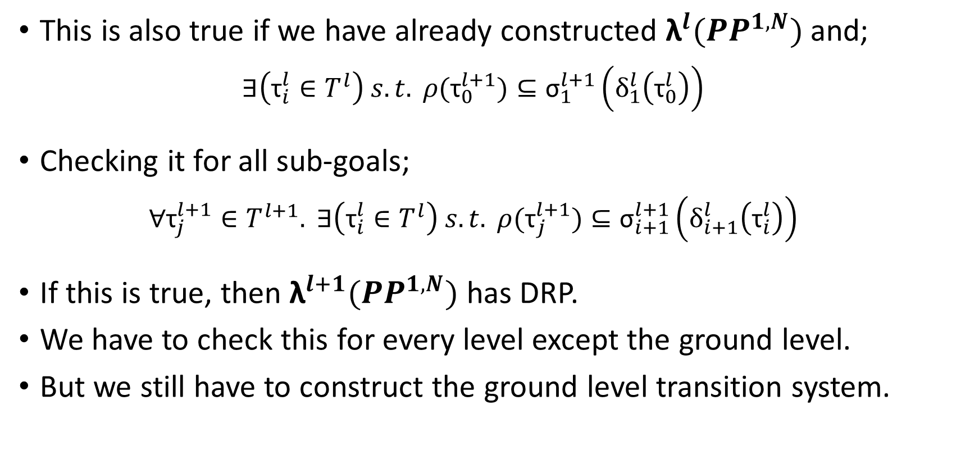
Downwards Refinement Property
This is also true if we have already constructed ${\text{λ}}^{l}({PP}^{1,N})$ and;
$$∃\left({\text{τ}}_{i}^{l}∈T^{l}\right) s.t. {ρ(\text{τ}}_{0}^{l+1})⊆{\text{σ}}_{1}^{l+1}\left(δ_{1}^{l}\left({\text{τ}}_{0}^{l}\right)\right)$$
Checking it for all sub-goals;
$$∀{\text{τ}}_{j}^{l+1}∈T^{l+1}. ∃\left({\text{τ}}_{i}^{l}∈T^{l}\right) s.t. {ρ(\text{τ}}_{j}^{l+1})⊆{\text{σ}}_{i+1}^{l+1}\left(δ_{i+1}^{l}\left({\text{τ}}_{i}^{l}\right)\right)$$
If this is true, then ${\text{λ}}^{l+1}({PP}^{1,N})$ has DRP.
We have to check this for every level except the ground level.
But we still have to construct the ground level transition system.

Slide 30
Problems
DRP means can solve any sub-goal or any sub-sequence of sub-goals independently, and dividing on action effects allows interleaving, but;
How many sub-goals to solve per iteration? i.e. how far ahead to we plan?
Do we allow revision of previously planned actions at the same level?
If so, how far do we allow the planner to “look-back”?
Each decomposition tree may interact (so need to be interleaved), but we don’t know which ones…
If we know this, we would never need to make an revisions,
Allowing revisions mean that interacting trees that were previously made independent can be interleaved, but is expensive, work has to be re-done!
Possible to dynamically look-back if a sub-goal interaction is detected?

Slide 31
Modules of ASH: Planning

Slide 32
Modules of ASH: Conformance

Slide 33
Modules of ASH: Instance Relations
A typing system
Very important because it controls which constants replace variables occurring in rules of the planning domain definition.
Special override arcs of the type inheritance hierarchy define our novel type of domain model, roughened models.

Slide 34
Decomposition Trees
Each node is the head of its own tree.
Transition t^{l} achieves rho(t^{l+1}) if…
Conformant if…
Tree is complete if it is either at the ground level or is conformant.
Tree is absolute if is complete and all of its children are absolute.
Each tree is independently solvable.

Slide 35
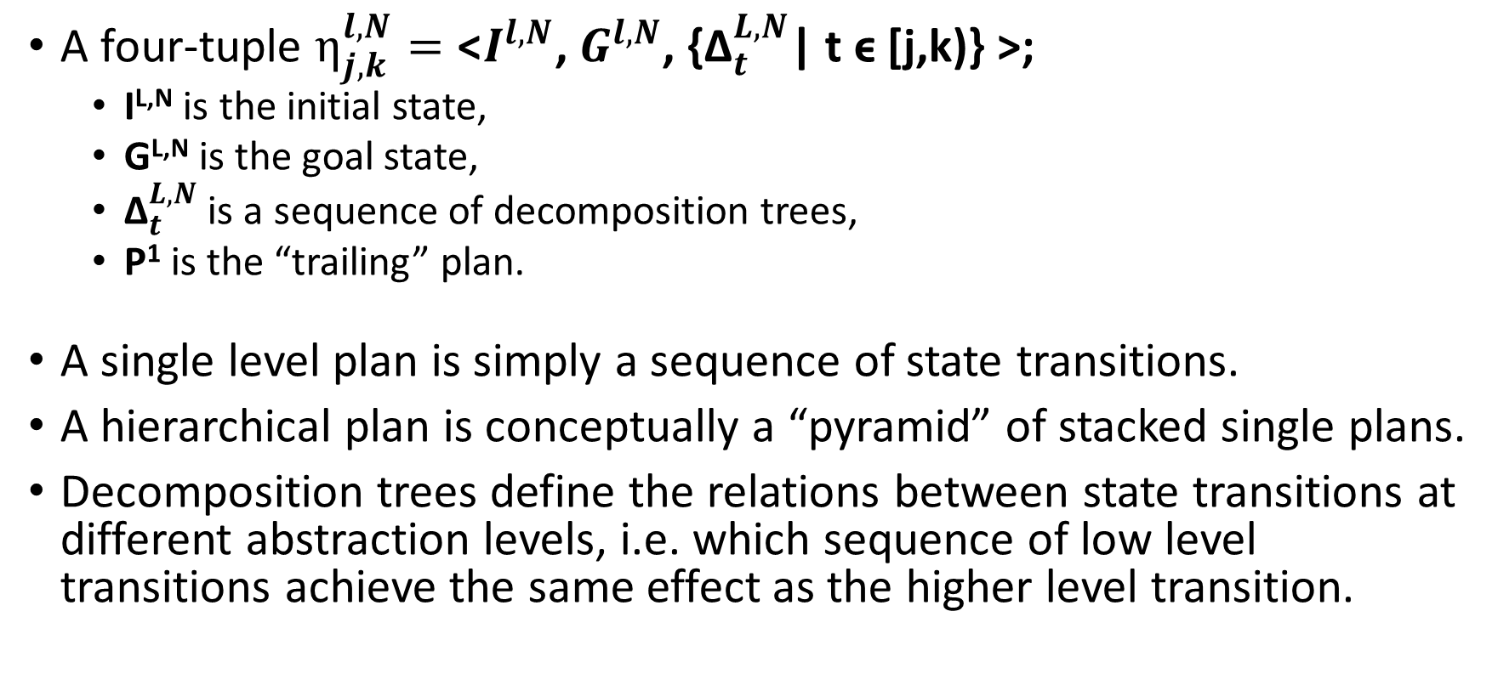
Hierarchical Plans
A four-tuple $η_{j,k}^{l,N}=\text{<}I^{l,N}\text{, }G^{l,N}\text{, \{}{\text{Δ}}_{t}^{L,N}\text{| }\text{t} \text{ϵ}\text{ [}\text{j}\text{,}\text{k}\text{)\} >}$;
I^{L,N} is the initial state,
G^{L,N} is the goal state,
${\text{Δ}}_{t}^{L,N}$ is a sequence of decomposition trees,
P¹ is the “trailing” plan.
A single level plan is simply a sequence of state transitions.
A hierarchical plan is conceptually a “pyramid” of stacked single plans.
Decomposition trees define the relations between state transitions at different abstraction levels, i.e. which sequence of low level transitions achieve the same effect as the higher level transition.

Slide 36
Hierarchical Plans
A hierarchical plan is complete at a given level if;
It has no trailing plan
Or the terminal state of its trailing plan achieves the goal state.
If every possible hierarchical plan is finalisable, then DD has the downward refinement property.

Slide 37
Domain Sorts
A typing system, fundamental because it controls the types of constants that replace variables occurring in rules of DD.
A tuple
A
F
C
H
Actions
Fluents and statics are domain properties, these are functions declaring state variables
Class hierarchy, an inheritance tree with a special type of relation called a type override, these are used in a novel type of abstraction employed by ASH.

Slide 38
Domain Sorts
Example

Slide 39
Domain Rules

Slide 40
Domain Rules
Example

Slide 41
Abstraction Mappings

Slide 42
Abstraction Mappings
Example
Why are these necessary?
Because the state space may not be the same at each level,
How are they defined?
Currently manually,
But there is a well defined way in which they should be written, so could be automatic

Slide 43
Domain Models
Constructed from the ground up
A tuple:
If AL = 1,
If AL > 1,

Slide 44
Relaxed Models
Simplest type of abstraction, based on assumptive reasoning;
Obtained by removing a condition prohibiting or penalising an action,
Assume the condition can be met by a sequence of actions at the next level,
Adds or reduces cost of arcs in a state transition system,
Result is large reduction in solution length.
Reductions are well defined and have the upward-solution property;
Existence of concrete solution implies existence of abstract solution,
This is because concrete solution is also solution to the abstract problem.
State space is identical, so state mapping is direct and one-to-one;
in^{L+1}(object) = location ← in^{L}(object) = location

Slide 45
Roughened Models
More complex, based on “ancestry” relations between classes and entities;
Obtained by relating entities to their components and removing a class type,
Based on concepts of resolution and granularity in explanation,
Reduces the number of entity constants and state space of transition diagram,
Result is large reduction in state space and solution length.
Refinements also well defined and have the downward-solution property;
Existence of abstract solution implies existence of concrete solution,
This is because concrete solution is also solution to the abstract problem.
State space reduces, so state mapping is direct but many-to-one;
inL+1(object) = location1 ← inL(object) = location2, desce_of(l, location1, location2)
State of roughened model seen as the union of the non-rough states that map to it.

Slide 46
What do we know about planning hierarchically?
The plan at level L can be no shorter than the plan at L + 1

